Slide 1
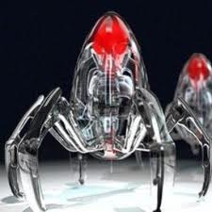
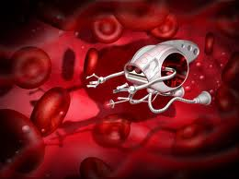
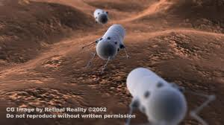
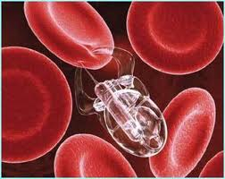
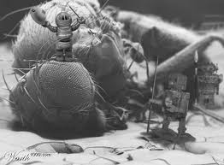
Nano Molecular Machines
Nanobots have certainly captured the public imagination:
thehottestgadgets.com
comicvine.com
retinareality.com
zeitgeistaustralia.com
singularityhub.com
A Hands-on Introduction to Nanoscience: WeCanFigureThisOut.org/NANO/Nano_home.htm

Slide 2
But popular concepts don't hold up well under critical analysis
You may already have picked up their many flaws in movies or books
But for a more detailed analysis you can also take a look at
my dissection of one best-selling Sci-Fi novel:
"The Fictions (?) of Nano Science Fiction"
Which concludes that fictional nanobots often cannot work as described
based on their disconnects with fundamental scientific laws!
A Hands-on Introduction to Nanoscience: WeCanFigureThisOut.org/NANO/Nano_home.htm

Slide 3
But what is wrong with "classic" nanobots?
Classic concept = Extreme miniaturization of life-sized technologies
That is, a Nano-transformer like mechanical robot
Let's analyze such an imagined nanobot step by step:
- How could we make the pieces of such a Nanobot?
- How would we get those pieces to assemble?
- Would they work even if we could get them assembled?
- How would their programming/direction be provided?
A Hands-on Introduction to Nanoscience: WeCanFigureThisOut.org/NANO/Nano_home.htm

Slide 4
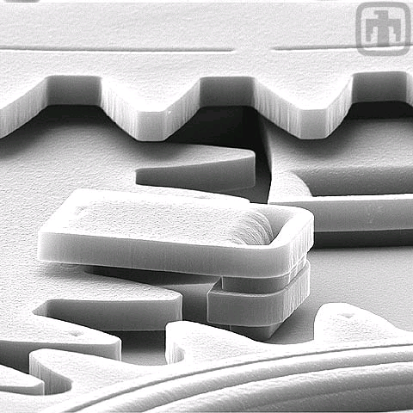
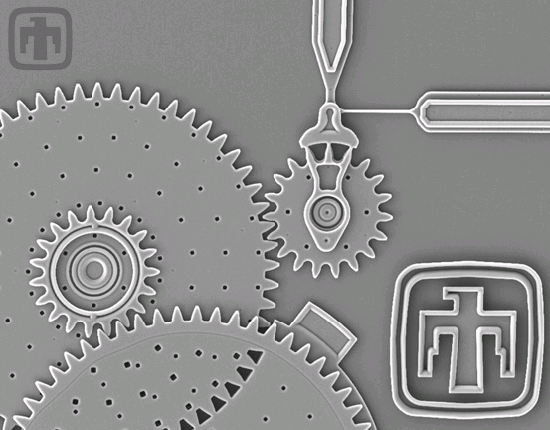
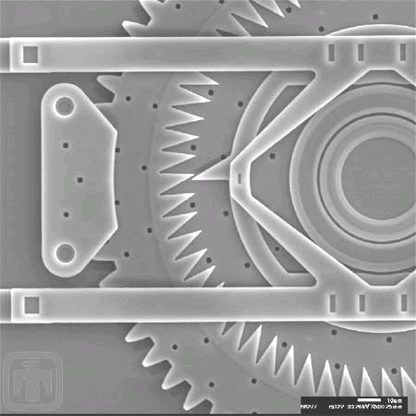
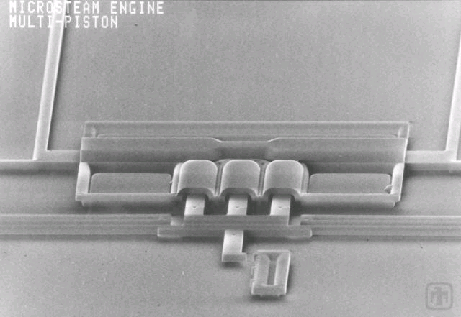
Closest we've come to this is MEMS
Remember (lecture 4)? MEMS = Micro Electro Mechanical Systems
Microns wide, tenths of microns thick, made via optical microfabrication
"Courtesy of Sandia National Laboratories,
SUMMiTTM Technologies, www.mems.sandia.gov"
A Hands-on Introduction to Nanoscience: WeCanFigureThisOut.org/NANO/Nano_home.htm

Slide 5
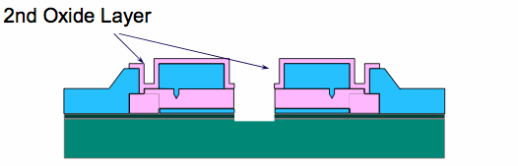
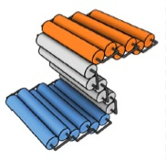
Extrapolating MEMS Technology:
Could we thereby make the pieces of a nanobot?
MEMS uses light-based lithography: Not quite nano (and never will be)
But we could use electron beam lithography - If we didn't care about time and cost
Could we thereby assemble the pieces of a nanobot?
MEMS elegantly side-stepped the assembly challenge:
Pieces were never fully separate
Were carved from connected layers:
Resulting structures essentially flat ≠ Classic 3D Nanobot
But we might then fold them as with DNA rafts:
A Hands-on Introduction to Nanoscience: WeCanFigureThisOut.org/NANO/Nano_home.htm

Slide 6
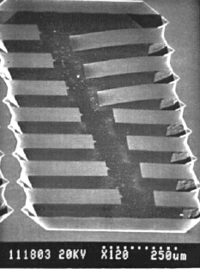
But would an extrapolation of MEMS-like technology work?
The cantilever beams that produce today's DLP projection TV's:
Vs.
That's the goal, but early cantilever beams ended up looking like this:
← Longer cantilevers drooped down
and "welded" themselves to substrate
Cause? Moisture!
More specifically: Surface tension of minute amount of residual water trapped between beam and substrate
T. Abe and M.L. Reed, J. Micromech & Microeng 6, 213 (1996)
A Hands-on Introduction to Nanoscience: WeCanFigureThisOut.org/NANO/Nano_home.htm

Slide 7
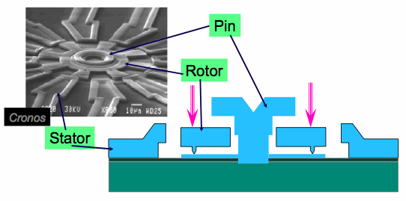
And even bigger problems surfaced for rotary / sliding motions:
Sandia's micro-transmission worked:
Small (30 μm) gear spun at 300,000 RPM
BUT seized up after 477,000 rotations:
477,000 / 300,000 → 95 second lifetime!!
Problem = "Stiction" = Sticking + Friction
- Sticking due to surface tension of captured water
Solution = Encapsulate in ultra dry environment
- Sticking due to Van der Waals bonding
Minimize contact area by adding bumps:
A Hands-on Introduction to Nanoscience: WeCanFigureThisOut.org/NANO/Nano_home.htm

Slide 8
Scorecard on MEMS inspired Nanobots:
- To fabricate at nanoscale would require excessive time + $ (via e-beam)
- 3D Geometries might be very limited (e.g. folded sheets)
- To work at all might require moisture-free environment
- Rotating pieces might operate for only seconds before seizing up
=> Why many discount possibility of mechanical (transformer) nanobots:
Essays such as "Rupturing the Nanotech Rapture"
Books such as Richard Jones' "Soft Machines"
A Hands-on Introduction to Nanoscience: WeCanFigureThisOut.org/NANO/Nano_home.htm

Slide 9
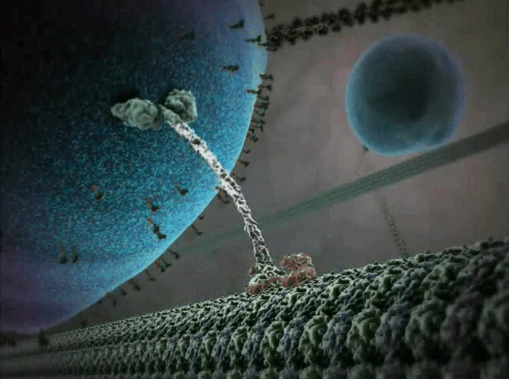
Have we indeed run into a wall? Time for a reality check:
Has mother nature come up with anything resembling a mechanical nanobot?
She sure has!
Harvard University's "The Inner Life of the Cell" animation:
Nano Molecular Machines - Supporting Materials – Cellular Visions 1
A Hands-on Introduction to Nanoscience: WeCanFigureThisOut.org/NANO/Nano_home.htm

Slide 10
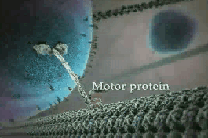
Or version with full technical narration:
Harvard University's "The Inner Life of the Cell" animation:
Nano Molecular Machines - Supporting Materials – Cellular Visions 2
A Hands-on Introduction to Nanoscience: WeCanFigureThisOut.org/NANO/Nano_home.htm

Slide 11
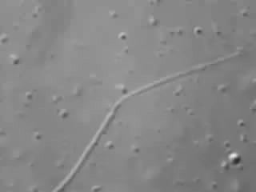
But is this only a computer animator's fantasy?
No, it's for real (as shown in this high-speed AFM movie):
Supporting webpage with embedded "Molecular Biology of the Cell" animation:
Nano Molecular Machines - Supporting Materials – Organelle Movement
A Hands-on Introduction to Nanoscience: WeCanFigureThisOut.org/NANO/Nano_home.htm

Slide 12
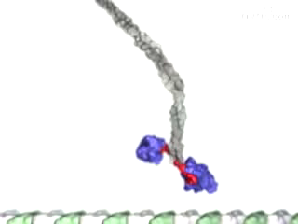
But HOW does it walk?
Supporting webpage with embedded
"Molecular Biology of the Cell" animation:
Nano Molecular Machines - Supporting Materials – Kinesin
OK, but what exactly are ADP and ATP?
And how would their "hydrolysis" produce all of these effects?
Specifically, how/why is shape of feet being changed? Answer:
Energy transfer and shape-shifting as protein wraps itself around ATP:
A Hands-on Introduction to Nanoscience: WeCanFigureThisOut.org/NANO/Nano_home.htm

Slide 13
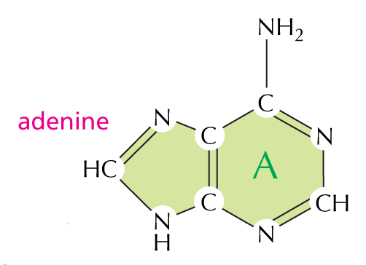
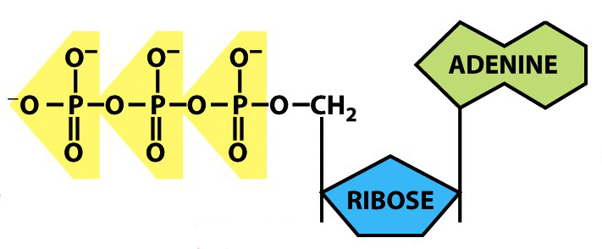
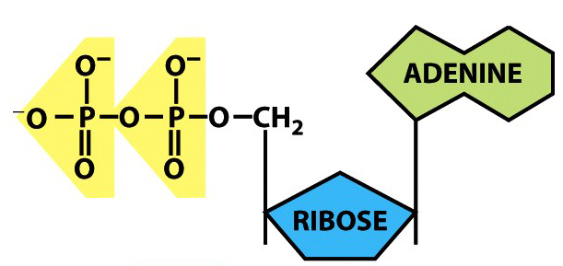
Energy is supplied by ATP to ADP conversion:
Adenosine Tri and Di Phosphate are based on Adenine (one of the four DNA bases):
ATP (3 PO₄ + Ribose + A) ADP (2 PO₄)+ Ribose + A)
+ H₂O => + .3 eV*
"Molecular Biology of the Cell" panel 2.6 and figure 2-27 *(= 7.3 kcal / mol)
A Hands-on Introduction to Nanoscience: WeCanFigureThisOut.org/NANO/Nano_home.htm

Slide 14
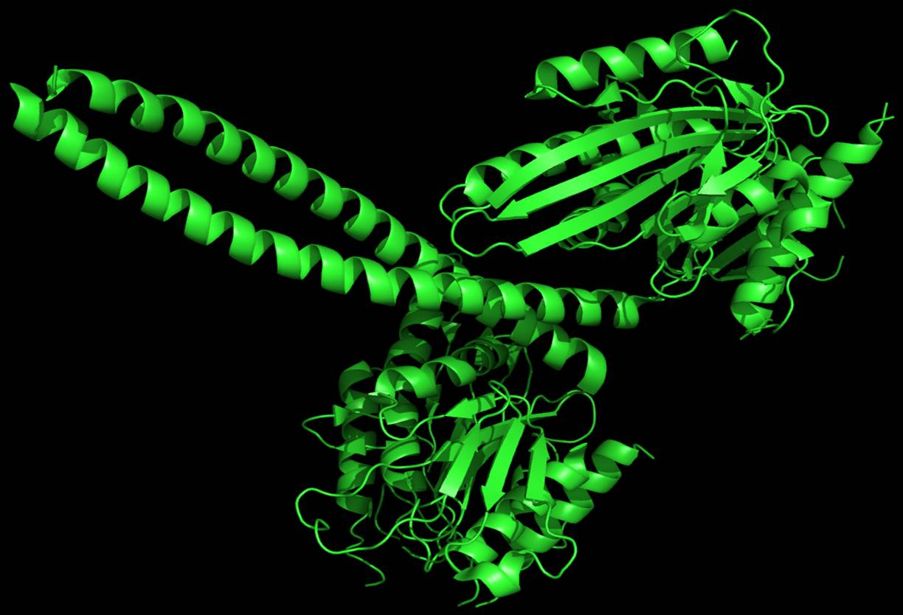
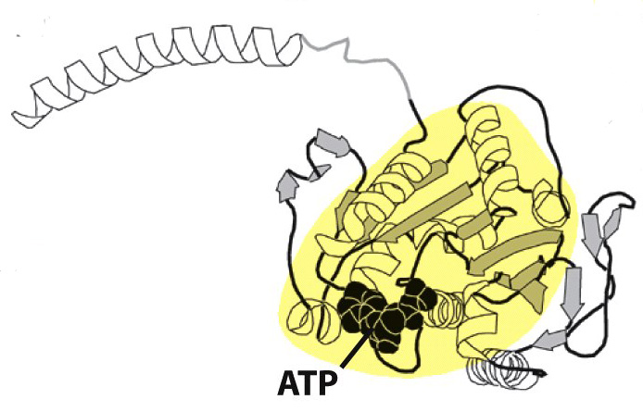
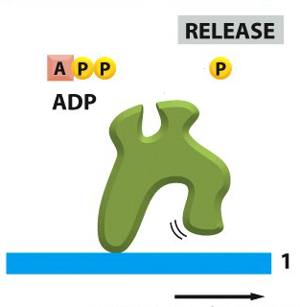
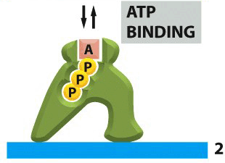
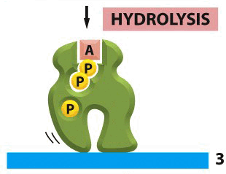
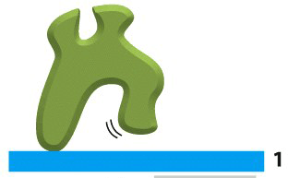
Which also drives the shape-shifting:
Detailed structure of kinesin protein (the feet) as determined by X-ray diffraction:
Full two-footed kinesin protein:
One foot with bound ATP:
Reshaping the feet/legs via ATP absorption, conversion to ADP, and its liberation:
"Molecular Biology of the Cell" figures 11-60 and 3-77
A Hands-on Introduction to Nanoscience: WeCanFigureThisOut.org/NANO/Nano_home.htm

Slide 15
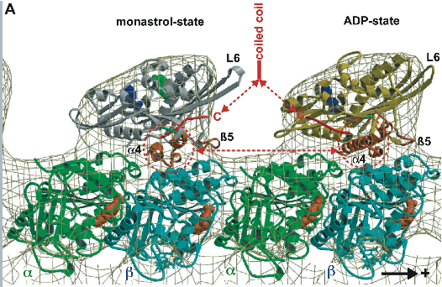
But are "they" sure that this is how kinesin works?
Details are still being worked out
An example from the Andreas Hoenger modeling group at U. Colorado, Boulder:
Microtubule at bottom (mesh, with embedded blue and green protein domains)
First kinesin protein foot wrapped around LEFT microtubule bump
Second kinesin protein foot, with embedded ADP, wrapped around RIGHT microtubule bump

Slide 16
Comparison with our classic mechanical nanobot:
Our "mechanical" way of building things:
Fixed frameworks / trusses / girders
Joined by pivot points / hinges
Determining single well-defined types and ranges of motion
Moved by gears
Driven by transmissions / pulleys / chains
Delivering and translating motion of discrete motor units
To which fuel is supplied via pipes or wires
Many DIFFERENT components each with a single/unique role
A Hands-on Introduction to Nanoscience: WeCanFigureThisOut.org/NANO/Nano_home.htm

Slide 17
Nature's approach is VERY different:
MUCH greater use of folding
Natural because biology's structures are based upon protein folding!
EVERYTHING is flexible
Where motion is required, just program flexing via chemical reaction
Built right into the part (no separate motor/transmission/hinge...)!
IMMERSE in SEA of fuel (i.e. no piping/wiring to only certain points)
Do minimum work necessary, leaving rest to Brownian vibrations
Kinesin "machine" provides only the latching and unlatching
Brownian motion does the rest: Swing of foot to new position
A Hands-on Introduction to Nanoscience: WeCanFigureThisOut.org/NANO/Nano_home.htm

Slide 18
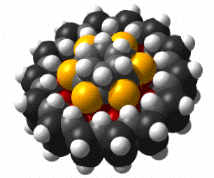
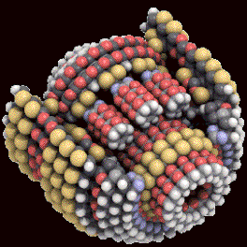
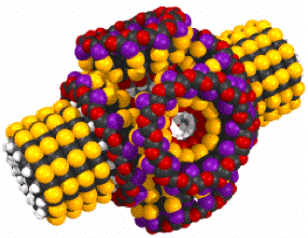
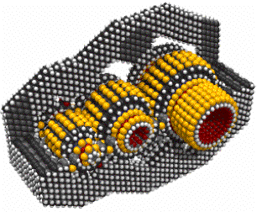
Returning to mechanical approach, but enlightened by nature:
Start by taking vibration and flexibility into account:
One group tackling this is led by futurist K. Eric Drexler
Working with computer modeling firm Nanorex
Which has proposed and modeled these nano-mechanical components:
Small Bearing Planetary Gear Differential Transmission
To see fully animated action of these gifs go to: Nano Molecular Machines - Supporting Materials - Nanorex
A Hands-on Introduction to Nanoscience: WeCanFigureThisOut.org/NANO/Nano_home.htm

Slide 19
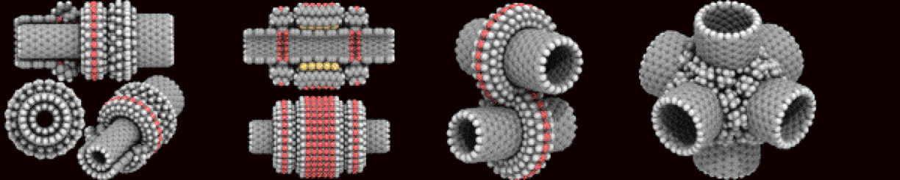
Or even more complex nanotube proposals:
But these ARE only computer modeled proposals
Which, some argue, underestimate vibrations and/or Van der Waals bonding
That is: Would they instantly vibrate apart, or seize together?
More importantly: HOW COULD YOU POSSIBLY ASSEMBLE SUCH THINGS?
In Nature: By attraction and fit, protein is layered upon protein
But in these models: One molecule is tightly wrapped around another molecule
How would we get larger molecule to bond around inner molecule?
Or squeeze inner molecule inside already complete outer molecule?
A Hands-on Introduction to Nanoscience: WeCanFigureThisOut.org/NANO/Nano_home.htm

Slide 20
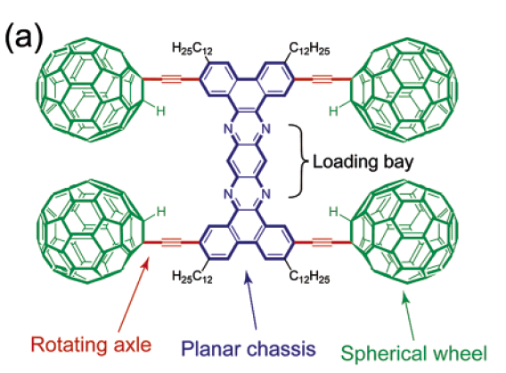
So time to again return to cold hard reality
Where my former collaborator Jim Tour is synthesizing NANOVEHICLES
A Hands-on Introduction to Nanoscience: WeCanFigureThisOut.org/NANO/Nano_home.htm

Slide 21
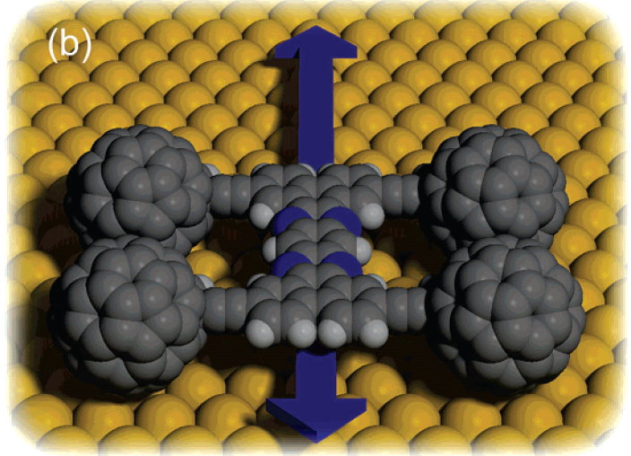
Can't visualize it yet?
How about this: "NanoTruck #1"
Shirai et al., JACS 128, 4854-64 (2006) link to copy of paper
A Hands-on Introduction to Nanoscience: WeCanFigureThisOut.org/NANO/Nano_home.htm

Slide 22
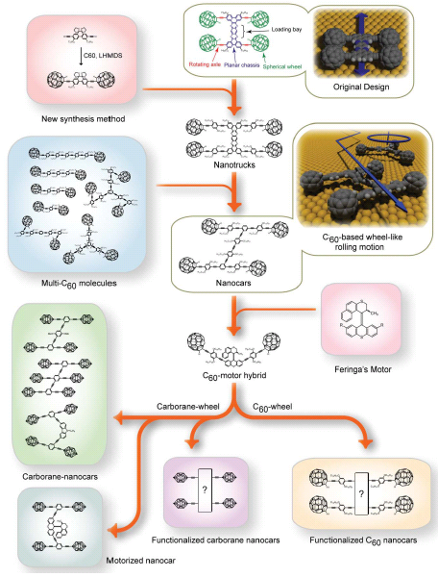
Leading to:
NanoTruck #1
NanoCar #5
Semis? (!$!@!)
NanoCar #9
Motors (!!@#!!)
Vehicles with a (chemical) agenda
Shirai et al., Chem. Soc. Reviews, 35, 1043-55 (2006) link to copy of paper
A Hands-on Introduction to Nanoscience: WeCanFigureThisOut.org/NANO/Nano_home.htm

Slide 23
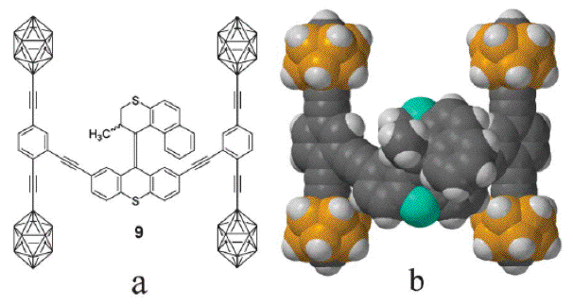
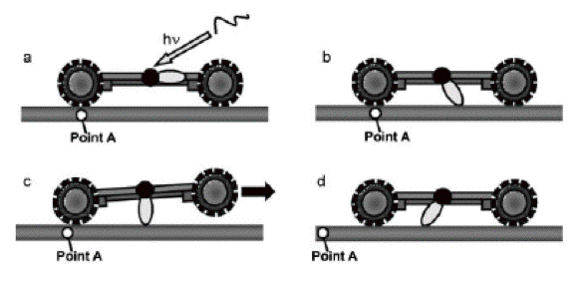
Reality (cont'd):
NanoCar #9:
With absorption of light spinning side group and "paddling" car along surface:
(But w/ p-carborane wheels not yet proven to rotate)
A Hands-on Introduction to Nanoscience: WeCanFigureThisOut.org/NANO/Nano_home.htm

Slide 24
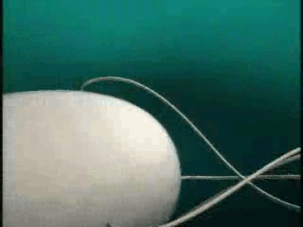
Or some awfully mechanical looking biology:
"Motor" driven propellers!
Supporting webpage with embedded Osaka U. animations:
Nano Molecular Machines- Supporting Materials – Flagella part 1
A Hands-on Introduction to Nanoscience: WeCanFigureThisOut.org/NANO/Nano_home.htm

Slide 25
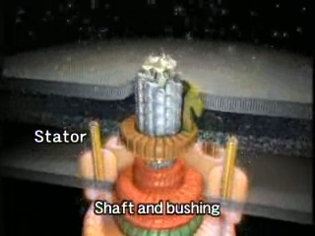
Which self-assemble:
Supporting webpage with embedded Osaka U. animations:
Nano Molecular Machines - Supporting Materials – Flagella part 2
A Hands-on Introduction to Nanoscience: WeCanFigureThisOut.org/NANO/Nano_home.htm

Slide 26
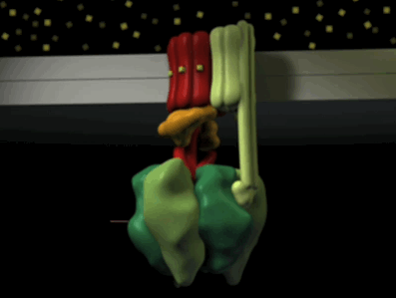
But how exactly did that motor work?
I could not find animation on the workings of that motor
But I did find this animation about a very similar biological motor:
Supporting webpage with embedded
"Molecular Biology of the Cell" animation:
Nano Molecular Machines - Supporting Materials – ATP Synthase part 1
A Hands-on Introduction to Nanoscience: WeCanFigureThisOut.org/NANO/Nano_home.htm

Slide 27
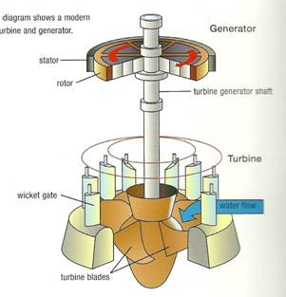
Time out for a translation:
Driven by "proton gradient across membrane"
Proton = hydrogen without its electron = hydrogen ion
Higher hydrogen ion concentration above = more acidic above
So it's powered by protons above, trying to get to lower "pressure" below
Sound familiar? (it should):
It's exactly how the turbines of a hydroelectric dam work!
U. Indiana
A Hands-on Introduction to Nanoscience: WeCanFigureThisOut.org/NANO/Nano_home.htm

Slide 28
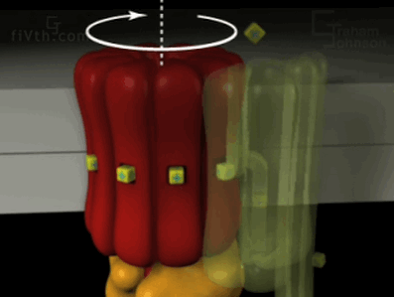
But this motor powers a fuel factory rather than a propeller:
Or, more precisely, an ADP to ATP converter:
Supporting webpage with embedded
"Molecular Biology of the Cell" animation (due to M. Yoshida, Tokyo Institute of Technology):
Nano Molecular Machines - Supporting Materials – ATP Synthase part 2
A Hands-on Introduction to Nanoscience: WeCanFigureThisOut.org/NANO/Nano_home.htm

Slide 29
What are "take away" lessons from Nature's nano machines?
- Nature uses designs with much less compartmentalization of functions
- Everything is going to be flexing and vibrating like crazy
- Nano forces and fluids are going to be unavoidable
But, surprisingly, Van der Waals + surface tension don't lock things up
Because, at this scale, Brownian vibrations knock them back apart!
So Nanorex style gears or transmissions might actually work!
Even though molecules WITHIN molecules may be impossible to build
More plausible would be self-assembly of molecule UPON molecule
As seen in protein self-assembly
A Hands-on Introduction to Nanoscience: WeCanFigureThisOut.org/NANO/Nano_home.htm

Slide 30
Suggesting that micron is WORST possible scale for mechanical robots:
Macroscale robots (human down to millimeter size):
Heavy inflexible pieces, totally oblivious to Brownian vibrations
And their momentum swamps effects of friction, surface tension, charging
Micron scale robots (such as MEMS):
Pieces still big enough to be inflexible, and to ignore Brownian vibrations
But reduced momentum countered by micro binding forces => Lock-up!
Functional (?) nano scale robots:
Pieces now so tiny that they have become light and floppy HENCE
Brownian vibrations toss them around like crazy WHICH PREVENTS
Forces of friction, surface tension or charging from locking them together!
A Hands-on Introduction to Nanoscience: WeCanFigureThisOut.org/NANO/Nano_home.htm

Slide 31
Footnote on the above hypothesis:
If flexibility IS the reason nanobots work well (while MEMS barely works)
We'd have to fight our inclination to try and make nanobots stronger!
For instance, while nanotubes and buckyballs might seem ideal components
Their exceptional STRENGTH might inhibit their flexing
Making it impossible for vibrations to un-lock them!
?
A Hands-on Introduction to Nanoscience: WeCanFigureThisOut.org/NANO/Nano_home.htm

Slide 32
Leaving one untouched point: Programming / Intelligence
Overall, construction of mechanical nanobots now seems MORE plausible
And, in biology, we can certainly find rich examples of programming
Programming at level of recognizing when nanobot has reached target
Or its programmed response when it does reach that target
For instance:
Viruses or antibodies identifying and acting upon their targets
But this is a really low level of programming
Based on random encounters and two things fitting together properly
A Hands-on Introduction to Nanoscience: WeCanFigureThisOut.org/NANO/Nano_home.htm

Slide 33
"Intelligence" is something quite different
Even bugs can deal with myriad stimuli and respond appropriately
Surely our classic nanobot needs to be as intelligent as an ant!
That seems to require a microprocessor's level of intelligence
Semiconductor microprocessors can contain ~ 10 billion transistor switches
Say, MAGICALLY, a single atom could replace a current day transistor
10 billion atoms in a dense cube would be ~¼ micron on a side
And that ignores need to provide routes for information flow (wiring)
Or other required "peripheral" things like:
Memory (RAM and hard disk), I/O, power supply . . .
A Hands-on Introduction to Nanoscience: WeCanFigureThisOut.org/NANO/Nano_home.htm

Slide 34
So even with assumption of atom-scale switches, memory cells, wires . . .
Seems FAR more likely that volume of robot mind will be microns on a side
And even that would assume an external power source (e.g. ATP sea)
Would-be smart mechancial NANObot => MICRObot, cell size or larger
OK, so what if it ends up really being a MICRObot!
It could still flow through my body doing wonderful repairs!
A Hands-on Introduction to Nanoscience: WeCanFigureThisOut.org/NANO/Nano_home.htm

Slide 35
Reality Check:
To achieve MICRObot size, I had to assume 1 atom switches/memory cells/wires
Nobody / Nothing has achieved this size/density of info / info-processing!
Let's again look to nature for what might in fact be ~ ultimate limit:
Single DNA unit is ~ 65 atoms occupying ~ pi (1 nm)² x 0.34 nm= 1 nm³
Assume that THIS is ~ ultimate limit for shrinking 1 switch / 1 bit of memory
1 nm³ per switch/memory unit = 1000X my assumed single atom volume
Meaning SMART MICRObot => MILLIbot: 10's -100's of microns on a side
Inject those guys into your body and all you're going to get is a stroke!
A Hands-on Introduction to Nanoscience: WeCanFigureThisOut.org/NANO/Nano_home.htm

Slide 36
All we seem to be left with is possibility of dumb nanobots
Things that could only randomly flow and diffuse through our bodies
And, at best, latch onto a specific target if they just happened to bump into it
Perhaps then delivering a drug, DNA insert . . .
FINE!
Don't discount how important such dumb nanobots might be!
Or how close we might be to engineering VERY USEFUL dumb nanobots!
A example is provided by recent Harvard research:
A Hands-on Introduction to Nanoscience: WeCanFigureThisOut.org/NANO/Nano_home.htm

Slide 37
Harvard's engineered nanobot:
Starts with "DNA Oragami" (as described in lecture "Bleeding Edge I: Nanomechanics"):
- An "off-the-shelf" master single strand of DNA is chosen
- A design is developed that lays out its 7308 nucleotide units something like this:
- "Staple" single DNA strands are then designed (196 different staples!)
With bases complementing the master strand where the staples should attach
Design was facilitated by CADNANO program co-developed by this team (www.cadnano.org)
Reference: "A logic-gated nanobot for targeted transport of molecular payloads, Shawn M. Douglas et al., Science 335, pp. 831-4 (2012)

Slide 38
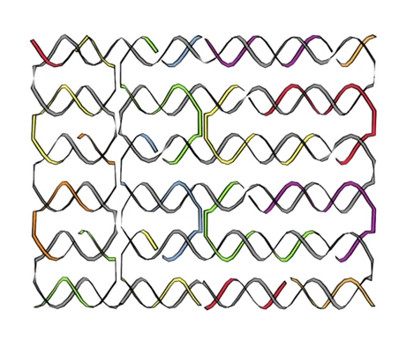
And it is then assembled:
By simply adding in the ~ 200 different DNA staple strands
And then slowly cooling, allowing complementary bases to bind together:
Supporting webpage with embedded Harvard animation:
Nano Molecular Machines - Supporting Materials – DNA Origami
Full animation + researcher interviews available at: http://wyss.harvard.edu/

Slide 39
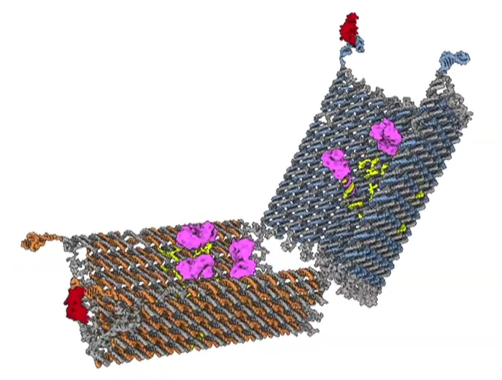
Leading to a full structure that looks like this:
Gray = long master single DNA strand
Orange + blue = Short DNA "staples" locking in master strand's 3D shape
Yellow = Staples with ends hanging out, attaching to purple "cargo"
Plus short DNA extensions at far-left / upper-right

Slide 40
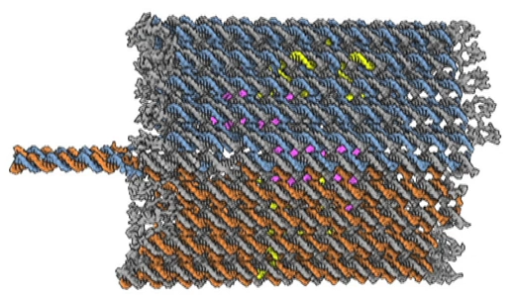
Short DNA extensions serve as LOCKS to fold structure together
Locks (2)
Twisted locks work because they consist of a pair of complementary single DNA strands
HOWEVER!
In each of THESE two locks, ONE of the DNA strands is very specially selected
So that, when unwound and disconnected, it curls into a complex shape
That can fit tightly around (and thus latch onto) a specific foreign molecule
THESE DNA strands were chosen to latch onto protein antigens
That are released by or embedded in the cell membranes of CANCER cells
Appropriate DNA recipes are cataloged in databases for specific antigens!

Slide 41
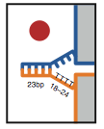
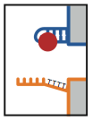
These antigen-binding single DNA strands are know as aptamers
If the antigen that a lock's amptamer targets is encountered:
That aptamer/DNA strand will untwist and instead latch onto the antigen:
And this "lock" opens
If the antigens for BOTH locks are present, BOTH locks unlock, and shell springs open!
Exposing the antigen-releasing
cell to the nanobot's deadly cargo
It even works if antigen spacing on target cell does not match separation of the two locks:
1st lock springs, then nanobot wiggles around cell surface until 2nd lock springs*
*Private communication with Shawn Douglas

Slide 42
Conclusions about Nanobots:
The fabrication of "classic" NANObots poses MAJOR mechanical design challenges
But these might be overcome by instead using bio-inspired floppy folded designs
But killer obstacle still seems to be INTELLIGENCE often attributed to NANObots
When I invoked imaginary atom-sized switches / bits I got a MICRObot
When I invoked DNA base-pair sized switches / bits it became a MILLIbot
But that DOES still leave the door open for DUMB NANObots
From which nature DOES get HUGE mileage!
And we're surprisingly close to engineering some REALLY USEFUL DUMB nanobots!
A Hands-on Introduction to Nanoscience: WeCanFigureThisOut.org/NANO/Nano_home.htm

Slide 43
Credits / Acknowledgements
Funding for this class was obtained from the National Science Foundation (under their Nanoscience Undergraduate Education program).
This set of notes was authored by John C. Bean who also created all figures not explicitly credited above (with the exception of lecture preview figures which are credited in their home set of lecture notes).
Copyright John C. Bean
(However, permission is granted for use by individual instructors in non-profit academic institutions)
A Hands-on Introduction to Nanoscience: WeCanFigureThisOut.org/NANO/Nano_home.htm

